Slide 1
Correspondence
Chapter: 6
Business Letters

Slide 2
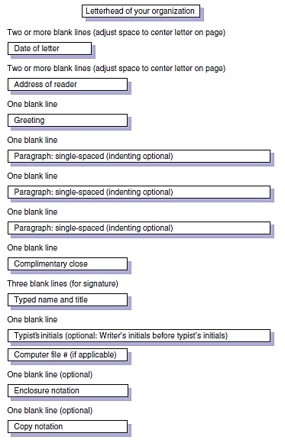
Notes:
1. Full Block Form
2. Modified Block Form
3. Simplified
Out of the three, this is Full Block format. All lines in the letter begin at the left margin (no tabbing or indenting)

Slide 4
Parts of a Letter
Letterhead of your Organization
Date
Inside Address
Subject Line
Salutation
Body
Complimentary Closing
Writer’s Signature Block
Your full name (typed)
End Notations CC

Slide 5
Heading or Letterhead
Place your full return address and the date in the heading (if no letterhead).
Avoid writing name (your name appears at the end of the letter)
Spell out words such as street, avenue, first, and west rather than abbreviating them.
The date usually goes directly beneath the last line of the return address. Avoid abbreviating the name of the month.
Begin the heading about two inches from the top of the page.
If you are using letterhead that gives the company address, enter only the date, below the last line of the letterhead.

Slide 6
Inside Address
the recipient’s full name
Title/designation
address in the inside address,
One line below the date, depending on the length of the letter

Slide 7
Subject Line
An important element in a letter is a subject line.
It follows the recipient’s address
Insert one blank line above and one blank line below the subject line.
The subject line in a letter functions as an aid in focusing the topic and filing the letter.
Subject lines are especially useful if you are writing to a large company and do not know the name or title of the recipient. In such cases, you may address a letter to an appropriate department or identify the subject in a subject line and use no salutation.
Notes:
(For information on subject lines, read pages 122–123 of The Business Writer's Handbook.)

Slide 8
Salutation
In most business letters, the salutation contains the recipient’s personal title (such as Mr., Ms., Dr.) and last name, followed by a colon (:).
If you are on a first-name basis with the recipient, use only the first name in the salutation.
Address women as Ms. unless they have expressed a preference for Miss or Mrs.
Professional titles (such as Professor, Senator, Major) take precedence over Ms. and similar courtesy titles.
When a person’s first name could refer to either a woman or a man, one solution is to use both the first and last names in the salutation.
Avoid “To Whom It May Concern” because it is impersonal and dated.
Dear Professor Ali and Dr. Alishba: [two recipients], Dear Ms. Asma, Ms. Aleena, and Mr. Asim: [three recipients], Dear Colleagues: [Members, or other suitable collective term].
In other circumstances in which you do not know the recipient’s name, use a title appropriate to the context of the letter, such as Dear Customer or Dear IT Professional.
Dear Sir/Madam
Notes:
Place the salutation, or greeting, below the subject and the inside address and align it with the left margin.

Slide 9
Body
The body of the letter should begin a line below the salutation
Leave a line within paragraphs
To provide a fuller appearance to a very short letter, you can increase the side margins, increase the font size and insert extra space above the inside address, the writer’s signature block, and the initials of the person typing the letter..
Components of Body:
  Purpose
  Details
  Call for Action
  Closing off
Notes:
Also read about the ABC format in the Correspondence guidelines.

Slide 10
Complimentary Closing
Type the complimentary closing a space below the body.
Use a standard expression such as Sincerely, Yours sincerely or Yours truly.
If the recipient is a friend as well as a business associate, you can use a less-formal closing such as Best wishes or Best regards or, simply, Best.
Capitalize only the initial letter of the first word, and follow the expression with a comma (,).

Slide 11
Writer’s Signature Block
Type your full name four lines below and aligned with the complimentary closing.
Sign the letter in the space between the complimentary closing and your name.
On the next line include your business title, if appropriate.
The following lines may contain individual contact information, such as a telephone number or an e-mail address, if not included in the letterhead or the body of your letter.

Slide 12
End Notations
Reference initials show the letter writer’s initials in capital letters, followed by a slash mark (or colon), and then the initials of the person typing the letter in lowercase letters (When the writer is also the person typing the letter, no initials are needed).
Enclosure notations indicate that the writer is sending material along with the letter (an invoice, an article, and so on).
Enclosure notations may take several forms: Enclosure: Final Safety Report
Copy notation (“cc:”) tells the reader that a copy of the letter is being sent to the named recipient(s).
Use a blind-copy notation (“bcc:”) when you do not want the addressee to know that a copy is being sent to someone else. A blind-copy notation appears only on the copy, not on the original (“bcc: Dr. Ali Afzal”).
Notes:
Business letters sometimes require additional information placed at the left margin.
two spaces below the typed name and title of the writer in a long letter, four spaces below in a short letter.

